Slide 1

Department of CSE
Course: AI & ML
Course code: 24AD2001A
Topic:
Anomaly Detection: Isolation forests, LOF.
Session – 35

Slide 2
Anomaly Detection: Isolation forests
Anomalies, also known as outliers, are data points that deviate significantly from the expected behavior or norm within a dataset. They are crucial to identify because they can signal potential problems, fraudulent activities, or interesting discoveries. Anomaly detection plays a vital role in various fields, including data analysis, machine learning, and network security.
Types of Anomalies
There are essentially three types of anomalies: point anomalies, contextual anomalies, and collective anomalies.
Point Anomalies (Global Anomalies): These are the most basic type, representing individual data points that are statistically unusual compared to the rest of the data. For instance, a credit card transaction with an exceptionally high amount might be flagged as a point anomaly.

Slide 3
CONTD..
Contextual Anomalies (Conditional Anomalies): These anomalies depend on the specific context or environment surrounding them. They often occur in time-series data, where patterns can change over time. An example is a sudden spike in temperature during winter within weather data.
Collective Anomalies: These involve groups of related data points exhibiting abnormal behavior collectively, even if individually they might seem normal. They disrupt the overall data distribution. Identifying collective anomalies often requires complex pattern-based algorithms, and they are commonly found in dynamic environments like network traffic data.

Slide 4
Isolation Forests for Anomaly Detection
Isolation Forest is an unsupervised anomaly detection algorithm particularly effective for high-dimensional data. It operates under the principle that anomalies are rare and distinct, making them easier to isolate from the rest of the data. Unlike other methods that profile normal data, Isolation Forests focus on isolating anomalies. At its core, the Isolation Forest algorithm, it banks on the fundamental concept that anomalies, they deviate significantly, thereby making them easier to identify.
Isolation Forests excel at anomaly detection by leveraging a unique approach: isolating anomalies instead of profiling normal data points. The workings of isolation forests are defined below:
Building Isolation Trees: The algorithm starts by creating a set of isolation trees, typically hundreds or even thousands of them. These trees are similar to traditional decision trees, but with a key difference: they are not built to classify data points into specific categories. Instead, isolation trees aim to isolate individual data points by repeatedly splitting the data based on randomly chosen features and split values.

Slide 5
CONTD..
Splitting on Random Features: Isolation trees introduce randomness at each node of the tree, a random feature from the dataset is selected. Then, a random split value is chosen within the range of that particular feature's values. This randomness helps ensure that anomalies, which tend to be distinct from the majority of data points, are not hidden within specific branches of the tree.
Isolating Data Points: The data points are then directed down the branches of the isolation tree based on their feature values.If a data point's value for the chosen feature falls below the split value, it goes to the left branch. Otherwise, it goes to the right branch. This process continues recursively until the data point reaches a leaf node, which simply represents the isolated data point.
Anomaly Score: The key concept behind Isolation Forests lies in the path length of a data point through an isolation tree.Anomalies, by virtue of being different from the majority, tend to be easier to isolate. They require fewer random splits to reach a leaf node because they are likely to fall outside the typical range of values for the chosen features. Conversely, normal data points, which share more similarities with each other, might require more splits on their path down the tree before they are isolated.

Slide 6
CONTD..
Anomaly Score Calculation: Each data point is evaluated through all the isolation trees in the forest.For each tree, the path length (number of splits) required to isolate the data point is recorded.
An anomaly score is then calculated for each data point by averaging the path lengths across all the isolation trees in the forest.
Identifying Anomalies: Data points with shorter average path lengths are considered more likely to be anomalies. This is because they were easier to isolate, suggesting they deviate significantly from the bulk of the data. A threshold is set to define the anomaly score that separates normal data points from anomalies. This threshold can be determined based on domain knowledge, experimentation, or established statistical principles.

Slide 7
Local Outlier Factor(LOF)
Local outlier factor (LOF) is an algorithm used for Unsupervised outlier detection. It produces an anomaly score for outliers in the data set. It does this by measuring the local density deviation of a given data point with respect to the data points near it.
Working of LOF
Local density is calculated by estimating distances between data points that are neighbours i.e k-nearest neighbors. For each data point, local density can be calculated by comparing these we can check which data points have similar densities and which have a lesser density than its neighbors. The ones with the lesser densities are considered as the outliers.
1. k-Distance and k-Nearest Neighbours
k-distance refers to the distance between a point and its k-th nearest neighbour. It helps define the local neighbourhood of a point by finding the closest k data points. Here is an image that represents the k-distances of various neighbours in the cluster of a point:

Slide 8
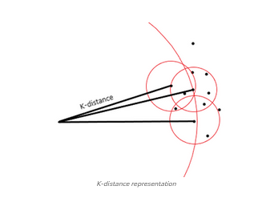
CONTD..

Slide 9

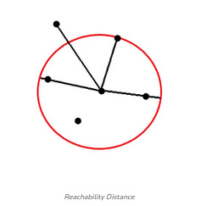
CONTD..
2. Reachability Distance
This distance is then used to calculate the reachability distance. It is defined as the maximum of the distance between two points and the k-distance of that point. Refer to the following equation where B is the point in the center and A is a point near to it.
Here is an image which represents reachability distance of a point to various neighbors:

Slide 10

CONTD..
As seen in the image above, for points inside the circle the k-distance is considered and for points outside the cluster, the distance between points is considered. Now, reachability distances to all of the k-nearest neighbours of a point are calculated to determine the Local Reachability Density (LRD) of that point.
3. Local Reachability Density (LRD)
The local reachability density is a measure of the density of k-nearest points around a point. It is calculated by taking the inverse of the sum of all of the reachability distances from the k-nearest neighboring points. The closer the points are, the distance is lesser and the density is more.

Slide 11

CONTD..
4. Local Outlier Factor (LOF)
The calculation of Local outlier factor (LOF) is done by taking the ratio of the average of the LRDs of k-number of neighbors of a point and the LRD of that point. Here is the equation for LOF:
So, if the density of the neighbors and the points are almost equal we can say they are quite similar; if the density of the neighbors is lesser than the density of the point we can say the point is an inlier i.e. inside the cluster, and if the density of the neighbors is more than the density of the point we can say that the point is an outlier.
Refer to the following illustration:
LOF ~ 1: Similar data point
LOF < 1: Similar data point which is inside the density cluster
LOF > 1: Outlier
Here is an image of the plot of LOF on a data set:

Slide 12
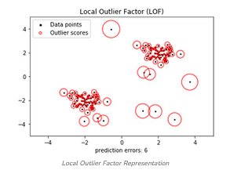
CONTD..

Slide 13
THANK YOU
Team – AI &ML

